Slide 1
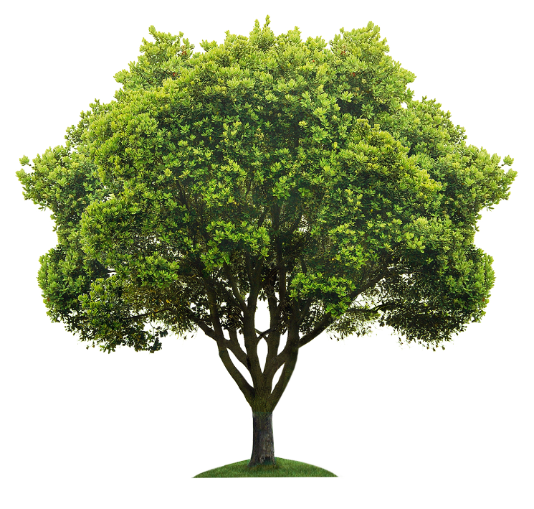
The WPW Plant Selection Tool
Tolerance
traits
To assist practitioners with plant selection and increase confidence in new and underutilised species
Will incorporate results of climate change modelling
Draws on grey literature, practitioner and horticulturalist knowledge
Aims to utilise the best aspects of existing plant selection tools
Plant selection
Multiple benefits
Practicalities
Notes:
To assist practitioners, we are assembling Trait database to identify multi-beneficial plant species suited to specific locations in urban green spaces
Includes new or underutilised species for better confidence in diversity of plantings
Incorporates the heat and drought tolerance projections from modelling
Draws on a range of sources including grey literature (e.g. council publications, Sydney Water) and horticultural knowledge (e.g. The Tree Standard, cultivation guides )
Takes the best features of other plant selection tools, including specific selection criteria for urban spaces such as playgrounds, water courses and foreshores, as well as updating information as new species and cultivars come on the market
The traits can be divided into:
diagnostic tolerance data, used to select the most likely plants for a particular location – e.g. aspect, soil, size at maturity, drought, heat, coastal tolerance etc
The multiple benefits plants can add to a space – e.g. ecological services, shading ability, sensory interest and aesthetics
The practical side of urban green spaces – maintenance associated with the species, longevity, irrigation needs

